Slide 1
Splunk Enterprise Security
SIEM Day 5
1

Slide 2

Class Objectives
By the end of class, you will be able to:
Differentiate between advanced security monitoring solutions, such as SOARs, UBAs, and UEBAs.
Understand how knowledge of SIEM software and Splunk is valued in the information security job market.
Work toward a Splunk certification using the Splunk Fundamentals eLearning program.
2

Slide 3
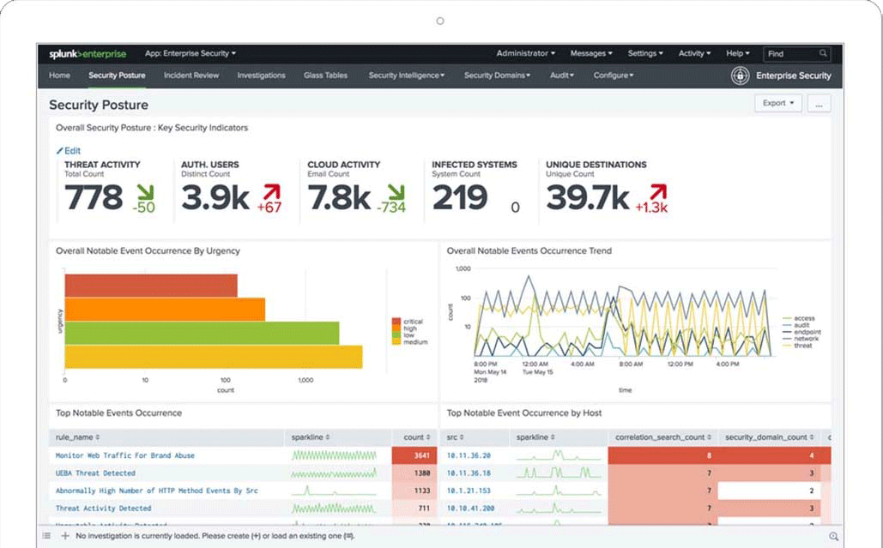
Splunk Enterprise Security
Throughout the past two units, we have covered many of Splunk’s capabilities and add-on applications.
The Splunk SIEM product, Splunk Enterprise Security (ES), is one of the most popular add-on products for security professionals.
(splunk.com)
3

Slide 4
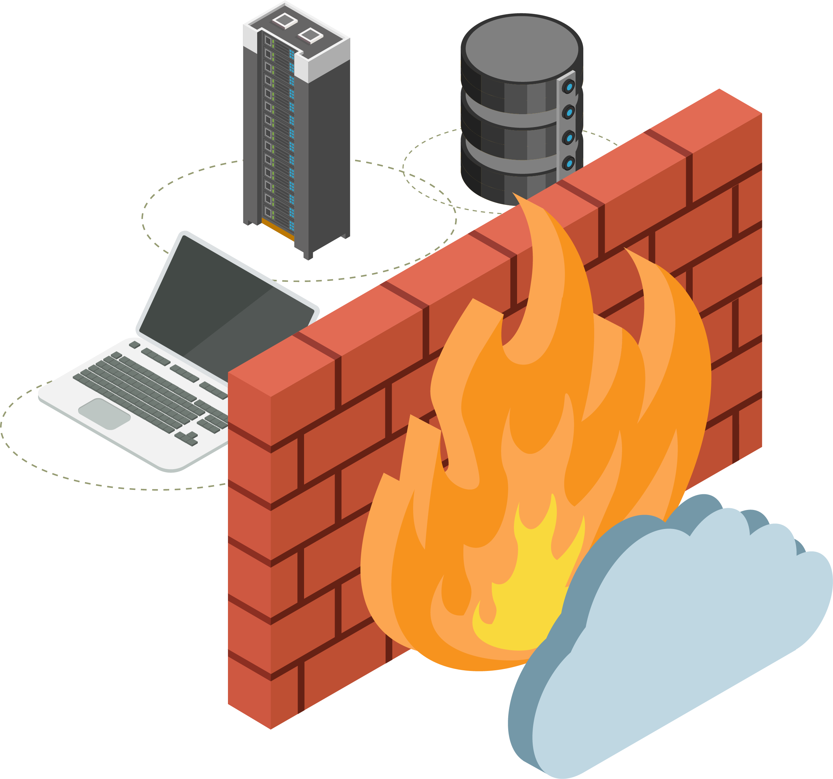
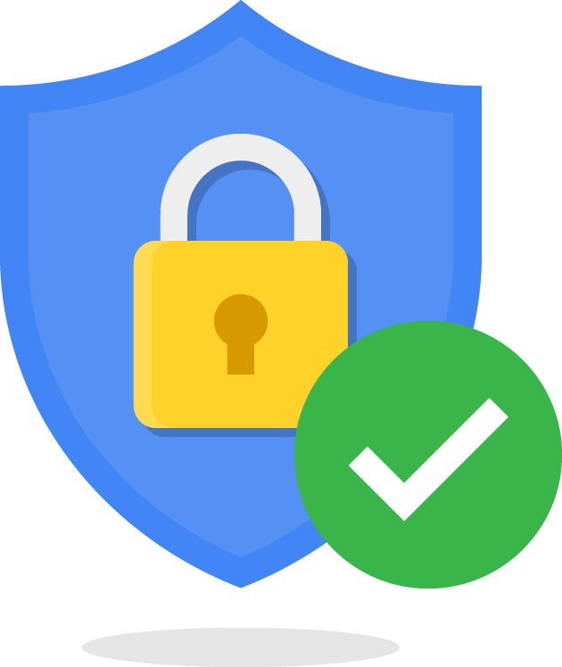

Splunk ES
Splunk ES is a SIEM product that provides security professionals insights from machine-generated data generated by such sources as:
01
02
03
Network devices like routers and firewalls
Endpoint devices like antivirus solutions
Vulnerability management systems like Nessus
4
Notes:
Shutterstock_792833623 shutterstock_693068344 shutterstock_693068344.png

Slide 5
Splunk ES
Splunk ES features allow you to:
Identify, prioritize, and investigate security events.
Gain insights into security events.
Monitor the status of your security environment.
Audit your security events.
Navigate these tasks with a pre-built, easy-to-use interface.
5

Slide 6
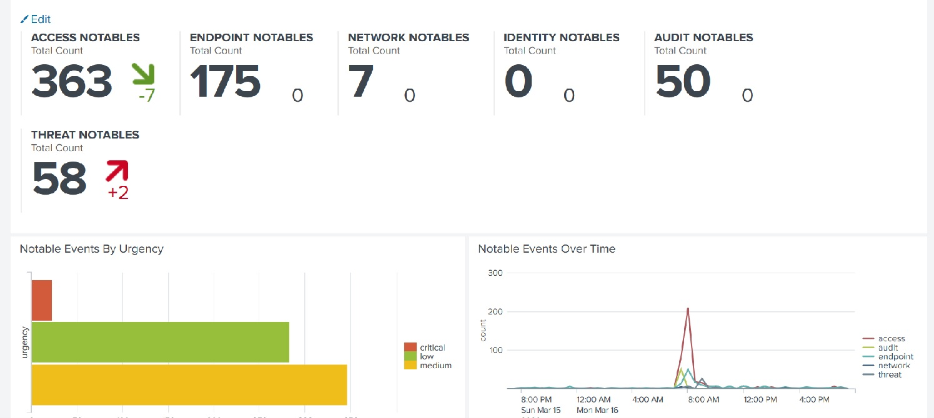
Splunk ES
Here’s an example of a basic Splunk ES dashboard.
6

Slide 7

Advanced security monitoring solutions provide additional benefits such as machine learning, artificial intelligence, automation, and response.
Notes:
shutterstock_650430397

Slide 8
Advanced Security Monitoring
Advanced security monitoring solutions provide additional benefits such as machine learning, artificial intelligence, automation, and response.
The most popular advancements in the information security industry are:
UBA
User Behavior Analytics
UEBA
User and Entity Behavior Analytics
SOAR
Security Orchestration, Automation, and Response
8

Slide 9

UBA is a security monitoring tool that uses machine learning, artificial intelligence, and data processing to detect abnormalities in user activity.
9

Slide 10
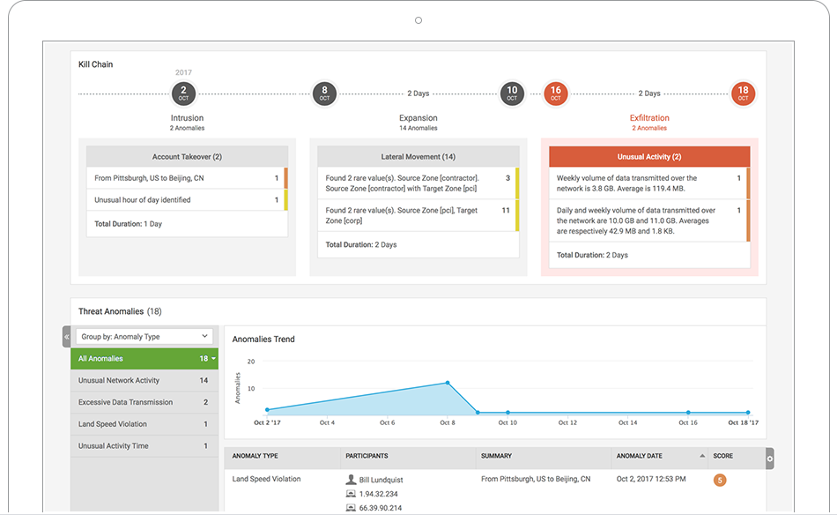
User Behavior Analytics (UBA)
UBA gathers information about typical user behaviors and creates baselines.
For example
UBA can gather information on the servers and systems that a user accesses as well as when and how frequently they do so.
UBA then creates alerts when a user's activity deviates from their typical behavior.
If they usually only log onto a server between 9 a.m. and 5 p.m., Monday through Friday, UBA would create an alert if the user logged in on at 2 a.m. on a Saturday.
(splunk.com)
10

Slide 11
UEBA is a security monitoring tool similar to UBA, except it extends monitoring to other “entities,” such as routers, servers, and IoT devices.
11

Slide 12
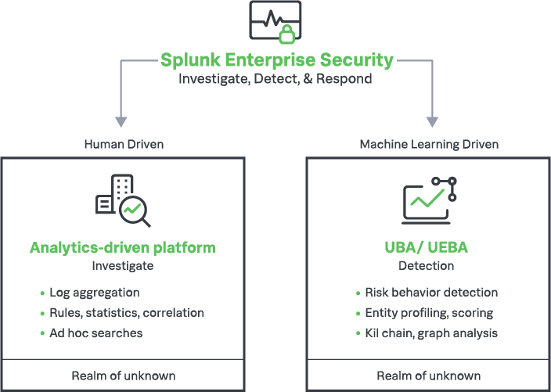
User and Entity Behavior Analytics (UEBA)
UEBA looks at typical user and entity behaviors and creates alerts when they display unusual activity.
(splunk.com)

Slide 13
SOAR is like a SIEM that automates security processes and responds to security incidents.
13

Slide 14


Security Orchestration, Automation, and Response (SOAR)
Examples of automating security processes include:
Examples of responding to security incidents include:
Creating logs.
Launching security investigations.
Assigning priorities to security incidents.
Threat mitigation.
Notes:
shutterstock_1608992503

Slide 15

Similar to a SIEM, SOAR gathers machine data from multiple entities and analyzes the data for security events.
15
Notes:
Image source: shutterstock_1083618569

Slide 16

SOAR uses playbooks that detail the processes and response actions for specific event.
For example, an organization can design a playbook to automate responses to phishing incidents.
(Source)
16
16

Slide 17

SOAR
This diagram illustrates how using SOAR playbooks can decrease incident response time.
BEFORE automation
TOTAL TIME
start to finish
3–5 mins
3–5 mins
10 mins per URL
30 mins per scan
3–5 mins
5–10 mins
5 mins
5–15 mins
75 minutes
Create a ticket
Check URLs and other IoCs
Analyze suspicious activity
Scan user endpoint for malware
Search for similar emails
Block incoming mail
Alert employees
Blackhole DNS
2 minutes
AFTER automation
Human decision
17
17
Notes:
Avatar AdobeStock_229758328

Slide 18
Activity: Advanced Security Monitoring Tools
In this activity, you will research SOAR, UBA, and UEBA vendors to find a best fit for your organization.
15 Minutes
18
18

Slide 19
19

Slide 20
Now, we’ll explore careers and certifications related to the Splunk knowledge and tools learned over the past five days.
20

Slide 21

Experience working with Splunk is a desirable qualification for many infosec positions:
SOC analysts work in a Security Operations department with security engineers. This role involves detecting, containing, and remediating information security threats. Most SOC analysts use SIEM products like Splunk ES to monitor their environment.
Cyber threat analysts analyze an organization's networks and applications to protect organizations from cybercriminals. They often use Splunk products to make predictions about cybercriminals and what attacks they may conduct.
Application security engineers can use Splunk to assist with fixing web and mobile application vulnerabilities. They use Splunk to analyze their application logs to assist with creating and testing their remediation.
21
Notes:
shutterstock_669170791

Slide 22

Experience working with Splunk is a desirable qualification for many infosec positions:
Network security administrators use products like Splunk to monitor suspicious network traffic such as DDOS attacks. They can use findings from Splunk logs to mitigate and prevent future attacks.
Incident response managers
can use Splunk to monitor the status of ongoing security investigations when an incident has occurred.
22
Notes:
Image source: shutterstock_1291533214

Slide 23
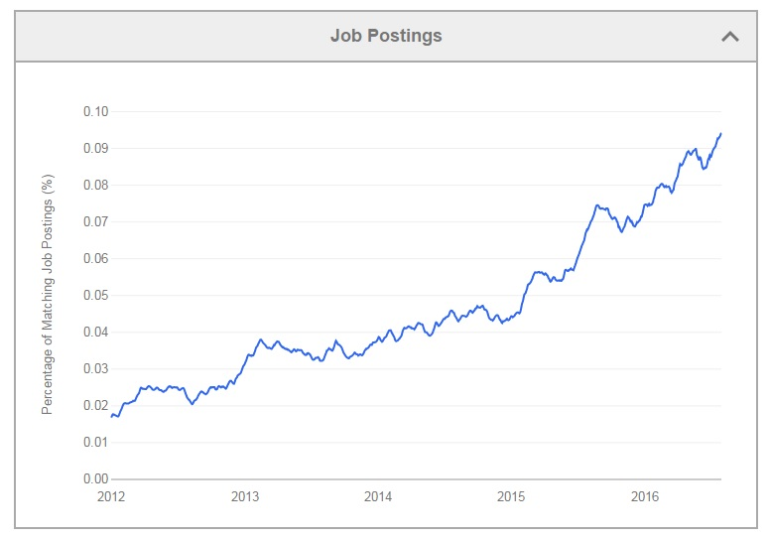
Splunk in InfoSec Careers
Splunk is already a required skill in many roles, and the industry demand is increasing every year.
(Source: Indeed)
23

Slide 24
Activity: Splunk Careers
In this activity, you will search several job sites for Splunk-related careers and answer questions about each position.
15 Minutes
24

Slide 25
25

Slide 26

26
Notes:
Image source: AdobeStock_56885471
Break

Slide 27
Similar to other domains in cybersecurity, Splunk skills are validated through certifications.
27
Notes:
Image source: shutterstock_1083618569

Slide 28
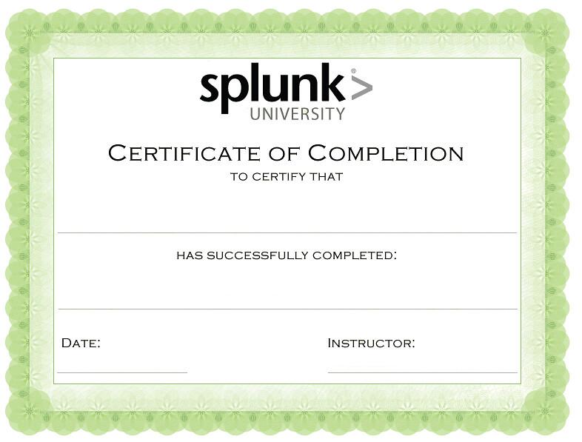
Splunk Certifications
Having a certification can help a cyber professional acquire a new position or receive a promotion, and can provide networking opportunities with professionals who have similar certifications.
Name Here
Date Here
First Name, Last Name
28

Slide 29
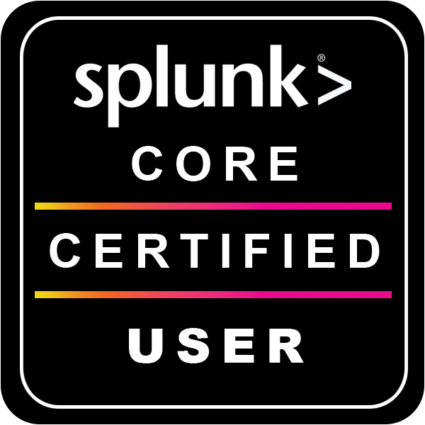
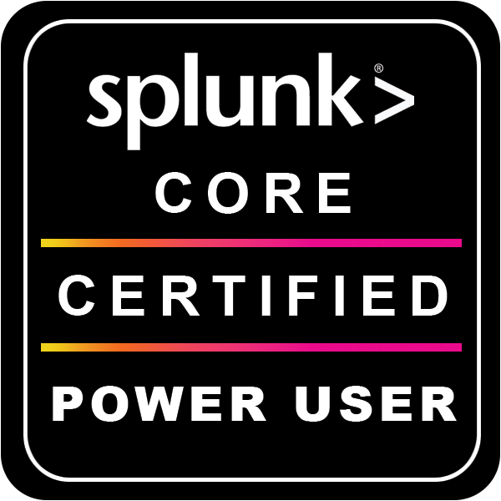
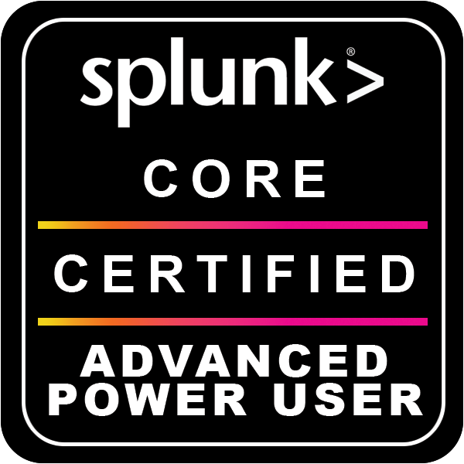
Splunk Certifications
Splunk offers many certifications, for a variety of skill levels.
Splunk Core Certified User
Splunk Core Certified Power User
Splunk Core Certified Advanced Power User
Entry-level certification that demonstrates a user’s basic ability to use the Splunk software.
Demonstrates a user’s foundational skills with Splunk’s core software, plus more complex skills, such as creating calculated fields and data models.
Demonstrates a user’s capability to design reports, complicated searches, and dashboards.
29

Slide 30
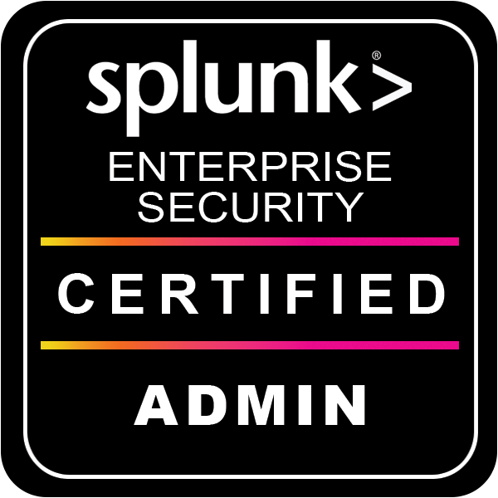
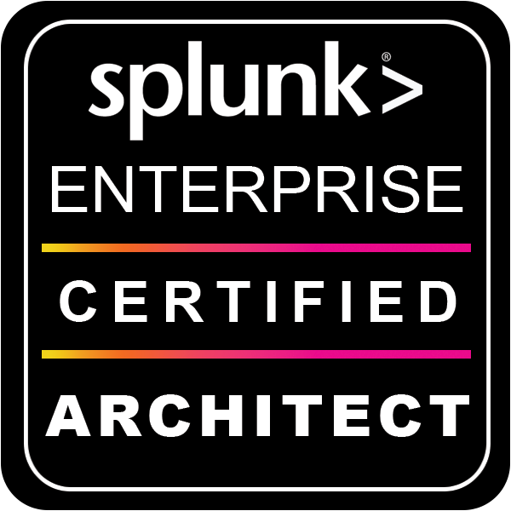
Splunk Certifications
Splunk offers many certifications, for a variety of skill levels.
Splunk Enterprise Certified Admin
Splunk Enterprise Certified Architect
Splunk Enterprise Security Certified Admin
Focused on an individual’s ability to support daily administrative tasks using Splunk Enterprise software.
Focused on a Splunk administrator's role supporting advanced troubleshooting, configurations, and deployments within Splunk Enterprise.
Focused on a Splunk administrator’s role to support installation, advanced troubleshooting, configurations and deployments within Splunk Enterprise Security.
30

Slide 31
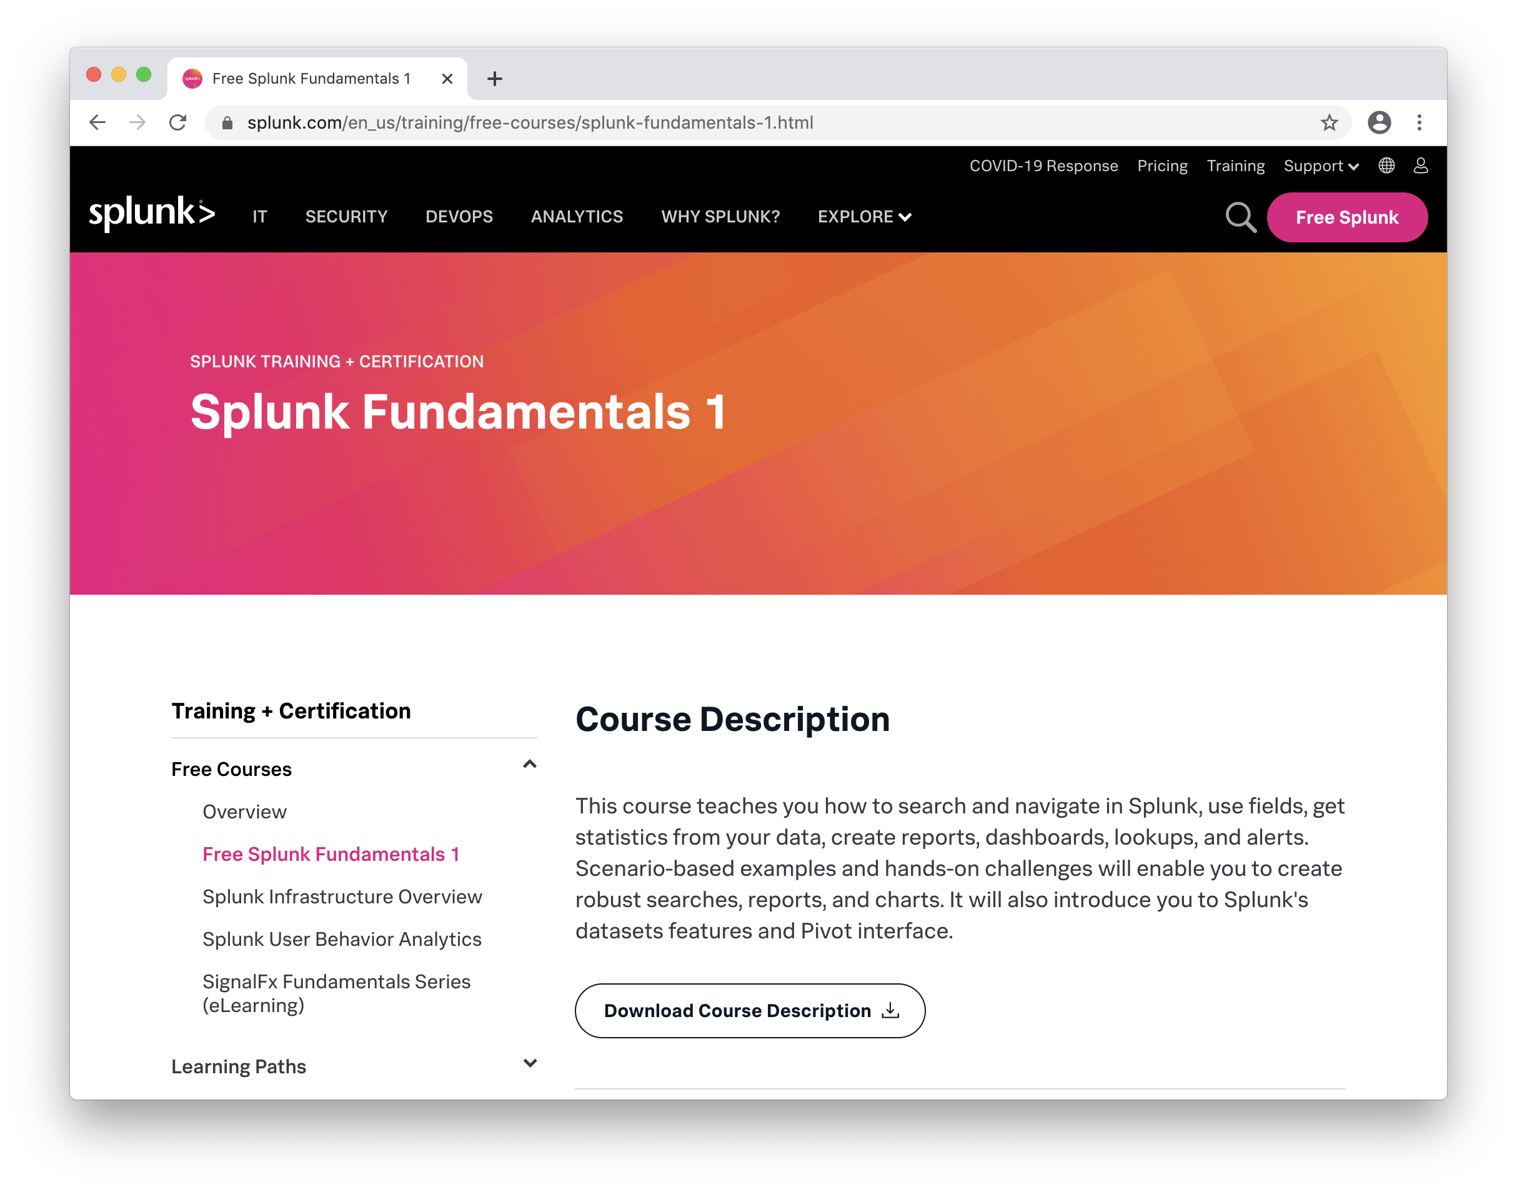
Splunk Certifications
Like many certifications in the infosec field, Splunk certifications are expensive.
Fortunately, Splunk offers the first certification class, Splunk Fundamentals 1, for free.
(splunk.com)
31

Slide 32
Activity: Splunk Certifications
In this activity, you will register for a Splunk account and begin the first three modules of the Splunk Fundamentals 1 certification.
50 Minutes
32

Slide 33
33

Slide 34
Splunk Certification
You are encouraged to complete the remaining modules on your own time.
Afterward, you can take the Splunk Fundamentals certification exam to earn a Splunk Certificate!
Name Here
Course Name Here
Date Here
First Name, Last Name
34

Slide 35

Next class, we will finish the SIEM unit with an activity incorporating everything we’ve learned about SIEM.
Notes:
shutterstock_1514413673

